Slide 1
Present (настоящее)
Present Simple
факт
Present Continuous
процесс
Present Perfect
результат

Slide 2
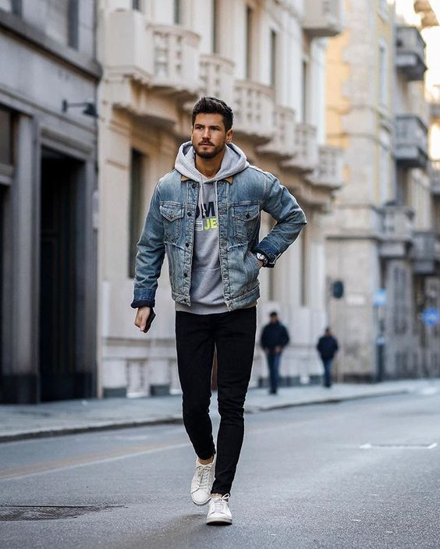
I’ve known him for 10 years.
https://ru.pinterest.com/pin/444449056974747112/

Slide 3
Present Perfect
recently, lately,
for, since,
this morning, this year…, today,
Just, already (+), yet (-, ?) so far (+, ?)
How long…?

Slide 4
Present Perfect: глаголы
правильные | неправильные
+ed [t] - washed [d] - played [id] – lasted, ended note – noted stop – stopped deny – denied play – played | III форма глагола (3 столбик таблицы) come – come put – put begin – begun

Slide 5
Present Perfect
I have cleaned the room.
We have cleaned the room.
You have cleaned the room.
He has cleaned the room.
She has cleaned the room.
It has cleaned the room.
They have cleaned the room.

Slide 6
Present Perfect
I haven’t cleaned the room yet.
We haven’t cleaned the room yet.
You haven’t cleaned the room yet.
He hasn’t cleaned the room yet.
She hasn’t cleaned the room yet.
It hasn’t cleaned the room yet.
They haven’t cleaned the room yet.

Slide 7
Present Perfect
Have I cleaned the room so far? Yes, I have. No, I haven’t.
Have we cleaned the room so far? Yes, we have. No, we haven’t.
Have you cleaned the room so far? Yes, you/I have. No, you/I haven’t.
Has he cleaned the room so far? Yes, he has. No, he hasn’t.
Has she cleaned the room so far? Yes, she has. No, she hasn’t.
Has it cleaned the room so far? Yes, it has. No, it hasn’t.
Have they cleaned the room so far? Yes, they have. No, they haven’t.

Slide 8
Present Perfect
What have you cleaned?
I have cleaned the room.
When has she cleaned the room?
When did she clean the room?
Вопрос к подлежащему
Who has cleaned the room? – They have.

Slide 9
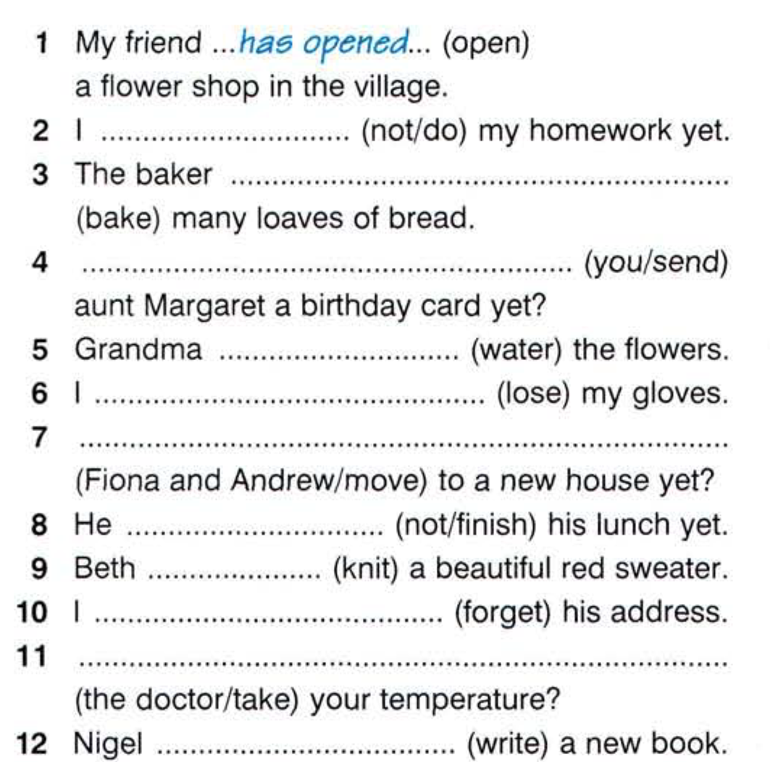

Slide 10
